Slide 1

Data Management in
PART-1
BY SUJATA SAHU, MS In Data Science

Slide 2
CONTENTS:
Why is Data management necessary
Steps Involved in Data Management
Introduction to R
Conclusion
Introduction
Execution in R

Slide 3

Why is Data management necessary?
Efficient storage
Data integrity and quality
Decision-making and analysis
Regulatory compliance
Data integration and interoperability
Data security and privacy
Data lifecycle management

Slide 4

STEPS INVOLVED IN DATA MANAGEMENT
Data Collection
Data Storage
Data Cleaning
Data Integration
Data Transformation
Data Security
Data Analysis.
Data Visualization
Data Maintenance
Data Disposal

Slide 5
INTRODUCTION TO R
Open source and free
Its specializes in statistical analysis, with specialized functions and packages.
Its extensive package ecosystem offers diverse functionalities for different domains.
It excels in data manipulation and transformation tasks, using packages like dplyr and tidyr.
Its powerful data visualization, especially with ggplot2, enhances effective communication.

Slide 6
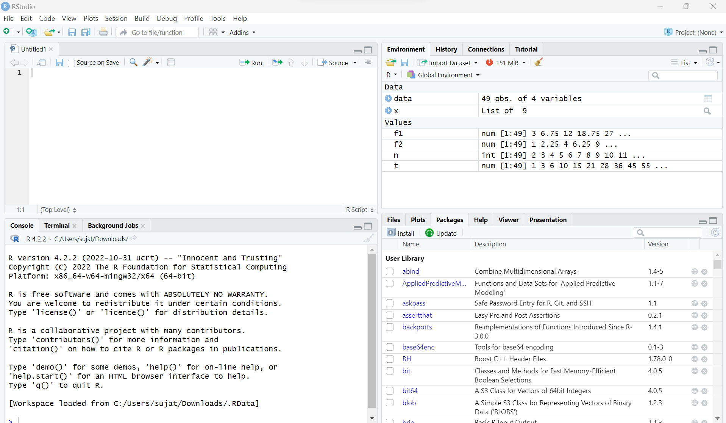

Slide 7

EXECUTION IN R
Data Import and Export
Data Manipulation
Data Aggregation
Data Cleaning
Data Transform
Data Sorting and Ordering:
Data Sampling

Slide 8

THANK YOU
Any Questions

